Slide 1
Nipah Virus Evolutionary Selection Analysis Update

Slide 2
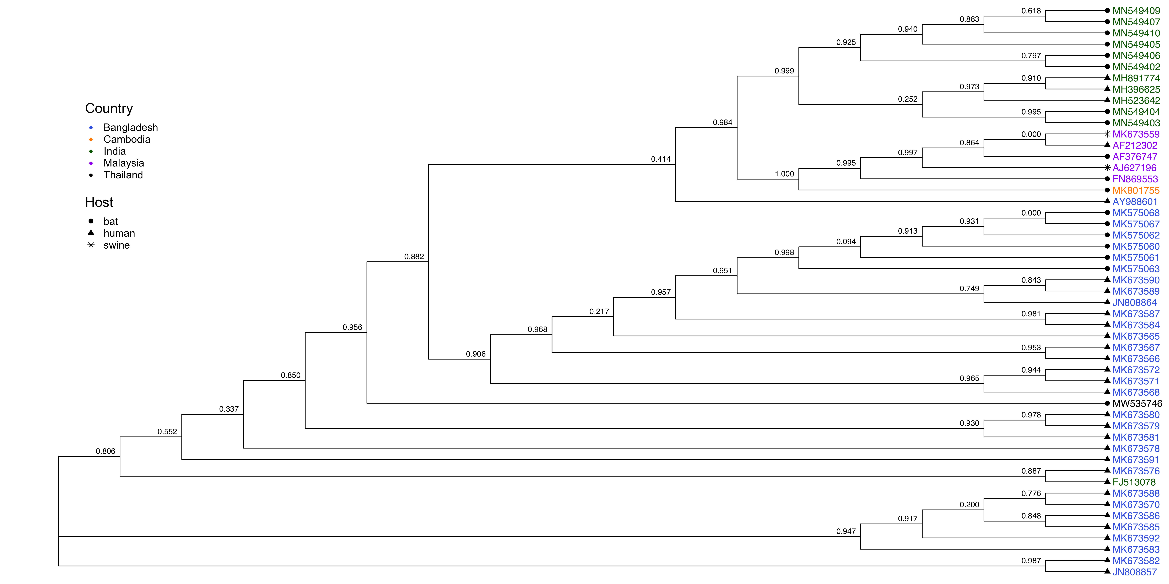
NiV Phosphoprotein, Unique Sequences
Notes:
MK575063 has a premature stop codon.
Look further at the sequences with 0 support. Maybe animals?
Maybe threshold like remove sequences containing more than 20% N nucleotides. Maybe leave for now until Maryska updates on what to do with it.

Slide 3
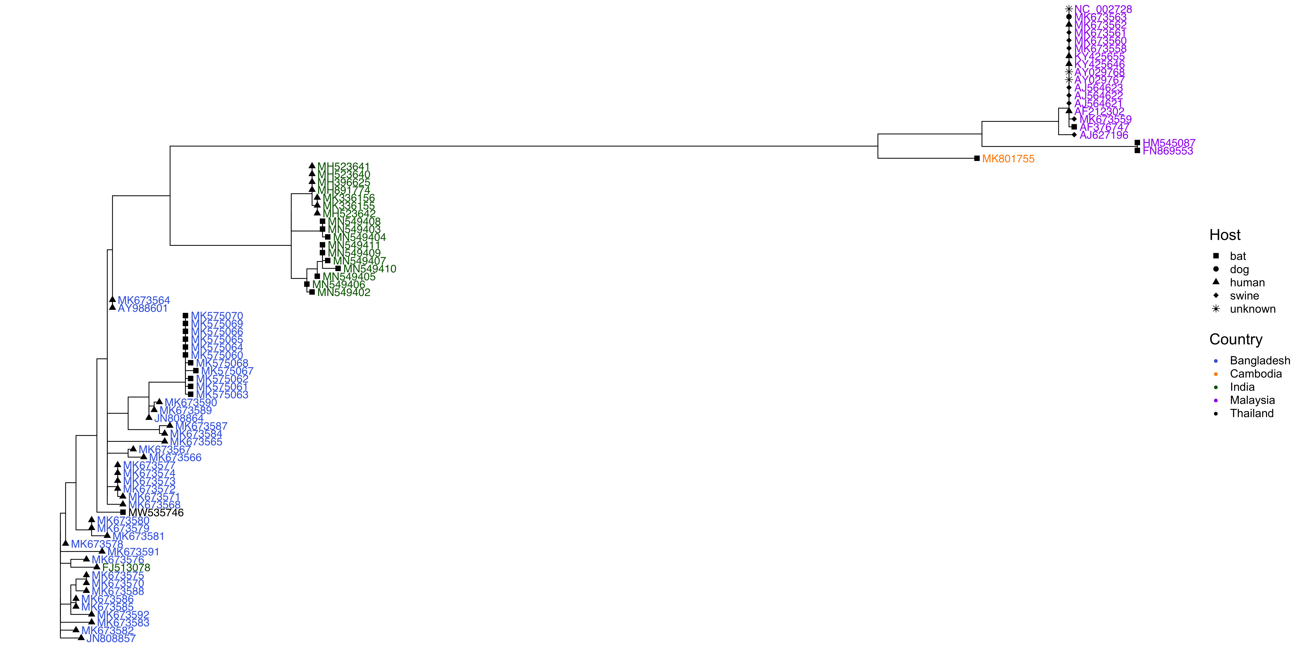
NiV Phosphoprotein, All Sequences
Notes:
Ask about how best to represent this?

Slide 4
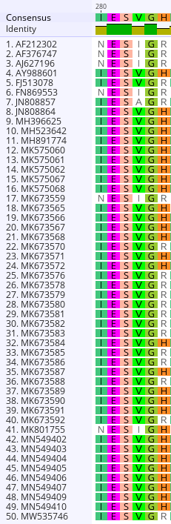
Sites under positive selection in phosphoprotein (FUBAR)
285
380
421
Notes:
FUBAR maybe better at detecting very weak positive selection.
Look at codon table to see how many nucleotides needed to change for the amino acid change to happen.
Look for correlations between the different sites and the different clades of NiV. Are they enriched in particular groups.

Slide 5
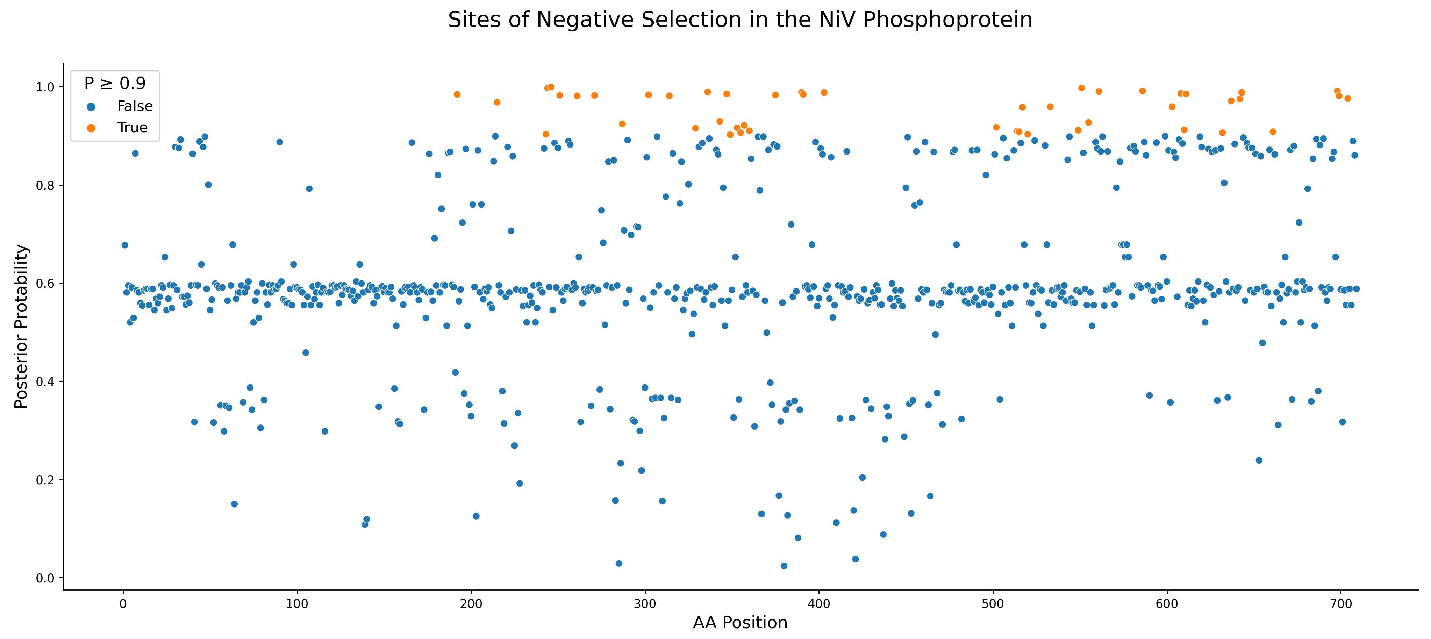
Notes:
Exact sites: 192-403, 502-704

Slide 6
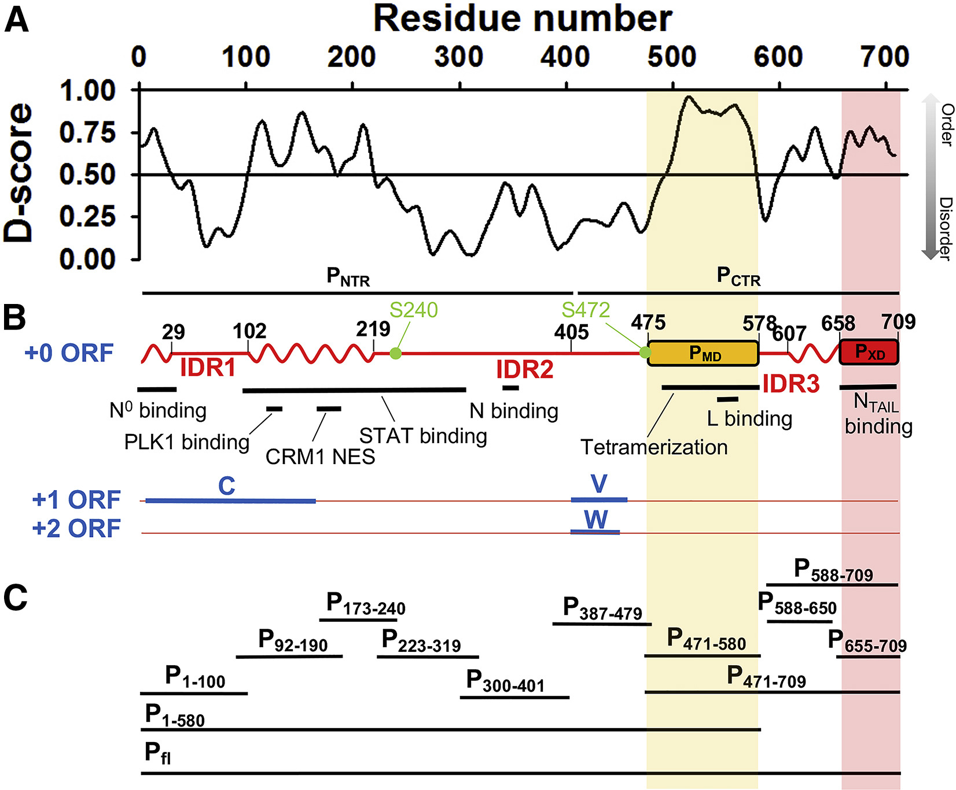
Jensen et al., Biophysical Journal, 2020
Notes:
Exact sites: 192-403, 502-704
Intrinsically disordered proteins may allow more mutations (diversifying selection) because structure isn't very constrained. BUT intrinsically disordered viral proteins also tend to bind a lot of other proteins. It's like both things at once -- constrained for binding, but unconstrained structurally.
Look at short proteins in evolutionary selection. If you have small proteins and small datasets, can you find anything? Look at some papers.

Slide 7
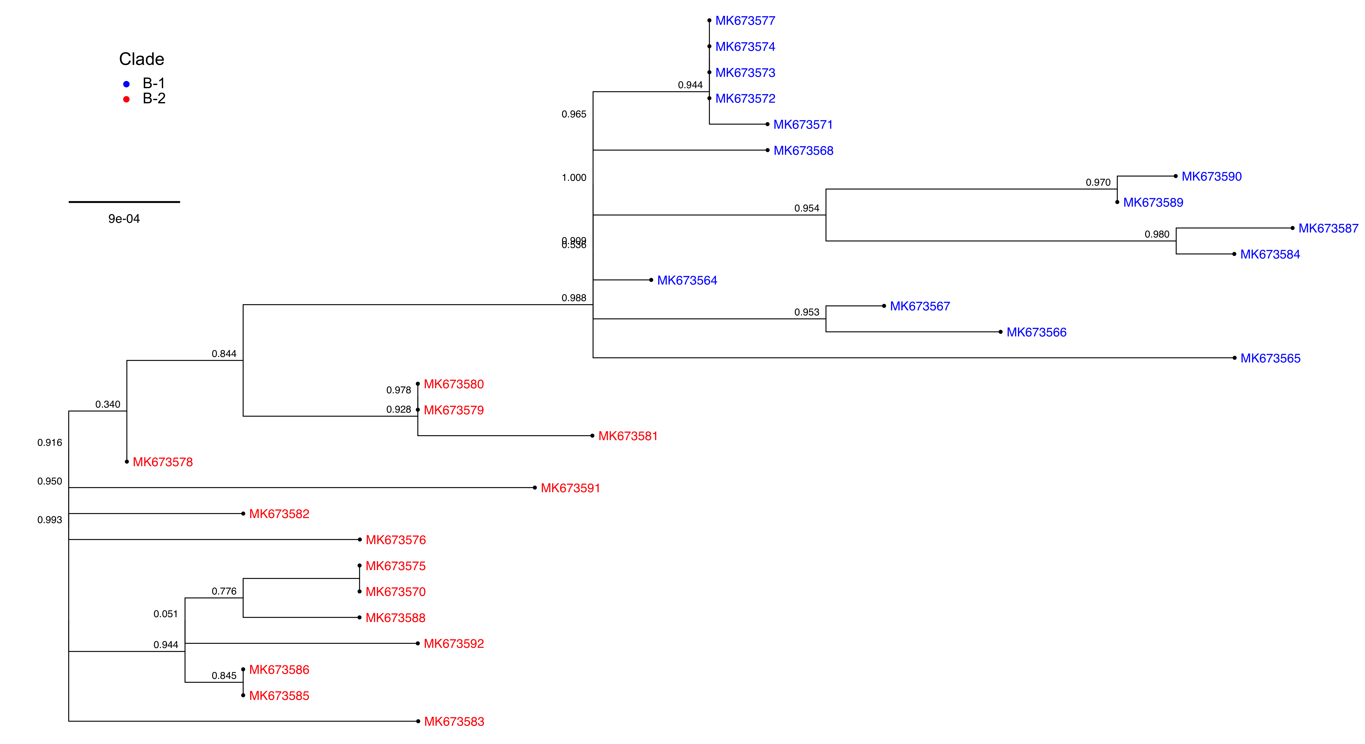
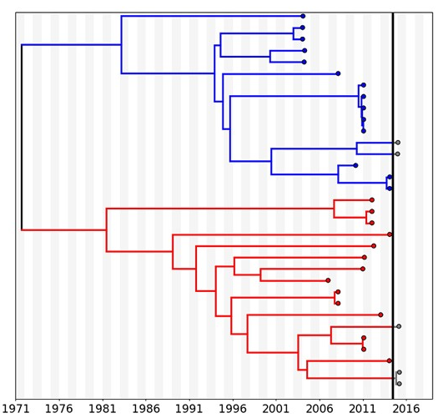
NiV Phosphoprotein Tree by Bangladesh Clades
Whitmer et al., Virus Evolution, 2021
Notes:
Clade or sublineage?

Slide 8
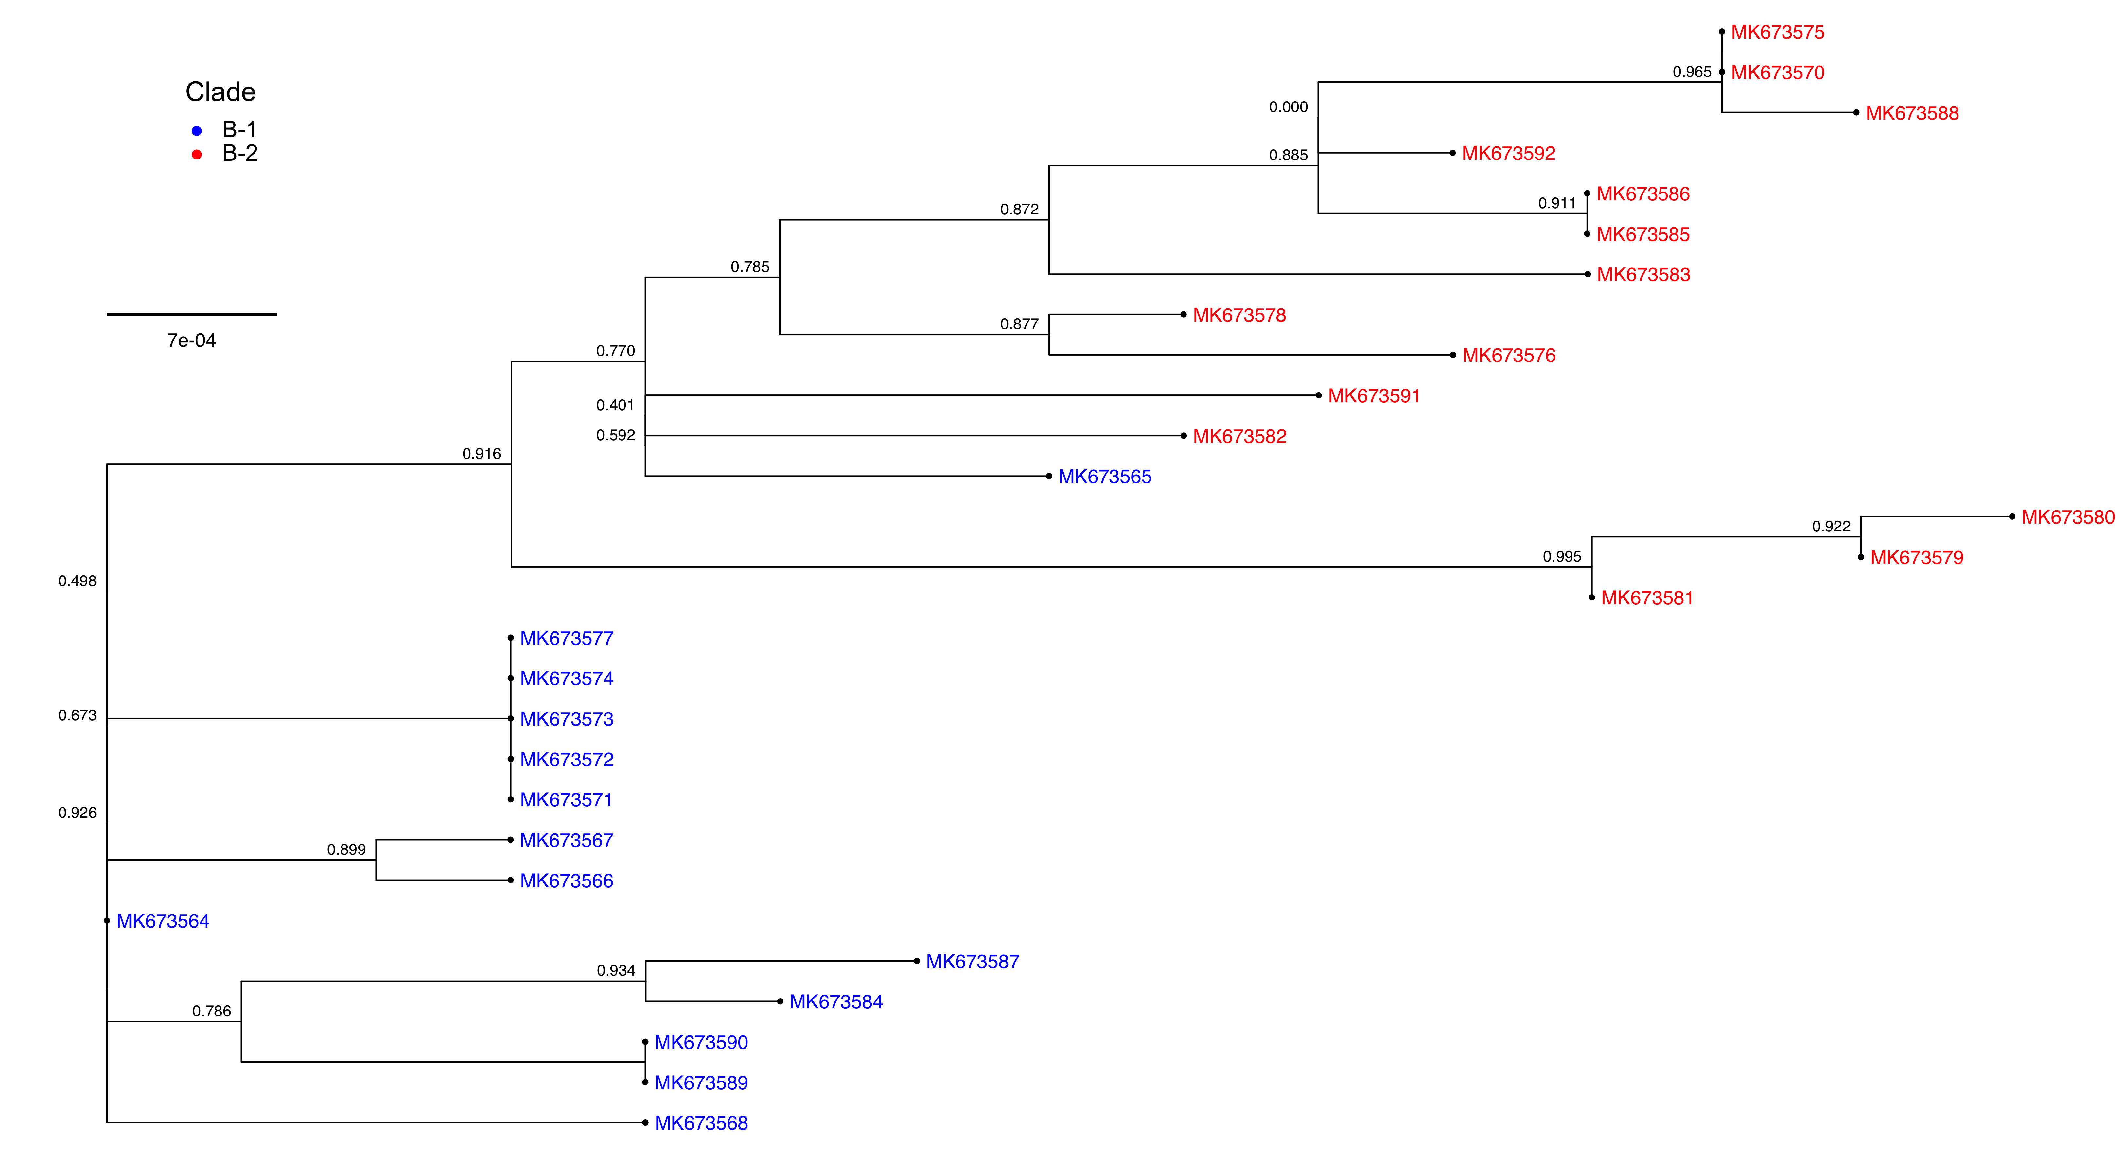
NiV Glycoprotein Tree by Bangladesh Clades
Whitmer et al., Virus Evolution, 2021

Slide 9
Questions
No full-length PDB structure for the phosphoprotein? Found for glycoprotein though. Phosphoprotein is very disordered. All 3 sites are in a disordered region. P is difficult to predict with AlphaFold because of all the disorder (low confidence throughout most of the protein, which probably explains the lack of crystal structures too)
How to assign Bangladesh clades? Are there defined differences between them somewhere? Whitmer et al. mentions clade-defining mutations in the polymerase gene, but perfect separation is also observed for G and P.
Good references on differences between the B-1 and B-2 clades?
Do a GWAS? GWAS of strains to identify significant differences between them?
Maybe perform feature downselection (after variant calling and SNP/indel threshold filtering) to see which genomic features associate best with B-1, B-2, and M?

Slide 10
